Slide 1

CPE 490 Embedded Systems Lecture 13
Type conversion

Slide 2
Exam Thursday
You will be allowed to bring one C reference, and the dsPIC33 data sheet
Format – T/F, explain, read code, write code.
Lectures – 1 through 11.
Concepts learned in lab are fair game.
Homework 1-3

Slide 3
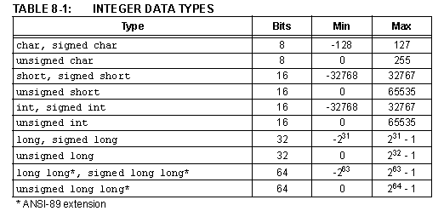
C Data Integer Data Types Signed by Default
Notes:
If you have
unsigned int c;
int d;
c= 60000;
d = c;
Then d will now be considered to be negative

Slide 4
C Type Conversions
In a previous lecture I said that the assignment operator will not do type conversions, THIS IS NOT TRUE.
Problems do occur when type conversions are done and the receiving type can not fit the answer.

Slide 5
Problem with Unsigned Numbers
int c;
char e=100,d=150;
c =e*d;
What is c? Not 100 * 150 = 15,000
But = -10600 ! How
char is a signed type so 150 => 150 – 256 = -106
Notes:
Remember two’s compliment is 2^N – X where X is number you desire to make negative. So if X= 1 then twos compliment is 65535 to represent -1. If you want to represent -32768 then 32768 would be used.

Slide 6
Problem with Overflow
long c;
int e= 30000,d=2;
c =e*d;
Answer = 60000?
Wrong answer = -5536
Math is done int * int. 60,000 is recognized as a negative number 2^16 – 60,000 = 5536 so it is recognized as a negative number.

Slide 7
Passing by Value in a Function
Type conversion is done if you use a different type to pass into a function then the one that it calls.
Again trouble if the target to be converted into can not be done.

Slide 8
LCD
A Liquid Crystal Display operates on the principle that liquid crystal can be organized when a voltage is applied to it.
A liquid crystal is sandwiched between two pieces of polarized glass. With no liquid crystal light can not pass through the polarized glass because of the polarization but with the crystal we get light to shine through (it looks gray)
Light can then be reflected off a mirror an returned to the eye in a controlled manner. When voltage is applied to a LCD pixel it organize in such a way to make the pixel opaque to the light and it turn in to black
The LCD we have is a pattern of rectangles. Each character space is made of 5 columns of 8 rows of these rectangles.

Slide 9
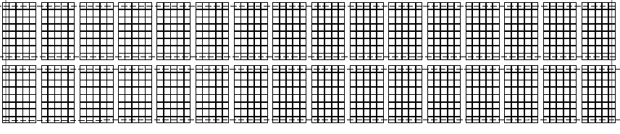
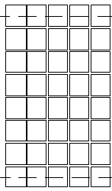

LCD Pattern

Slide 10
LCD Controller
The LCD controller is an IC, and a good example of a single purpose processor
The controller on the Explorer 16 board is compatible with the original HD44780 chipset.
The HD44780 is made by Hitachi and has been around since at least 1997. Now there are many companies that make the modules, like NOVATEK on the Explorer 16 demo board.

Slide 11
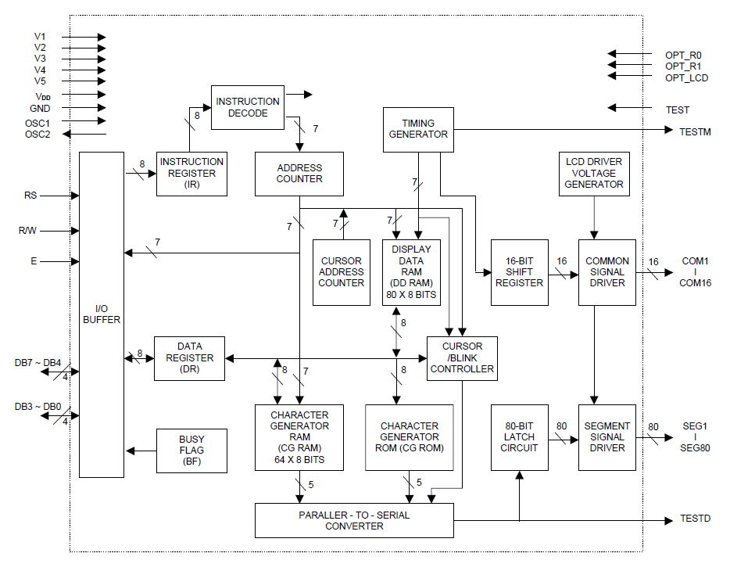
LCD Controller Block Diagram

Slide 12
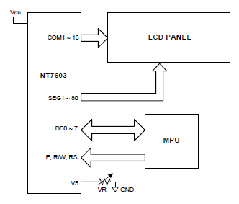
LCD Controller
The commands and displays are sent to the controller through a parallel interface. The controller output goes to the LCD itself.

Slide 13
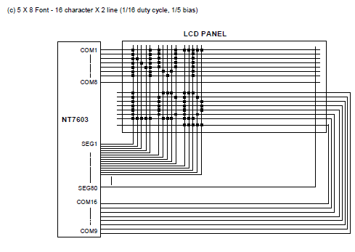
Controller Connection to LCD

Slide 14
LCD Display Data Ram (DDR)
One to one correspondence to an address location in DDR to what is written on the LCD as shown
00
01
0F
40
41
4F

Slide 15
LCD Controller Block Diagram
Notes:
80 bytes (0 -0x4F) in DDR but we will only use 32 bytes

Slide 16
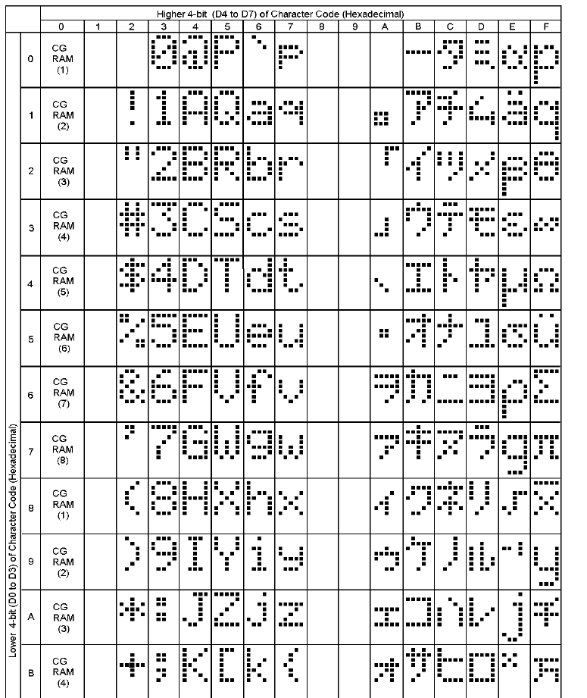
Character Generator ROM
Notes:
The Data Display Ram will have codes that represent characters, the code to character table is shown, and is in the data sheet. Column 0 will get character data from CGR. The columns 2-7 are the same as the ASCII code but with extension to include characters in columns B trough F.
For example J has a code of 4A

Slide 17
LCD Controller Block Diagram
Notes:
The actual bit patterns for the ASCII characters are contain in the ROM

Slide 18
LCD Character Generator RAM (CGR)
CGR allows you to define your own bit pattern for a character cell. Your can store up to 8 characters of custom graphics.
There are 64 addresses (0x40-0x7F) each address describes one row of the character. Address 0x40 is the top row of the first character and 0x47 will be the bottom most row of the first character. Address 0x48 will start the top row of character 2 and so on.
Writing the code 0-8 in DDR will display one of the 8 CGR defined characters.

Slide 19
LCD Controller Block Diagram

Slide 20
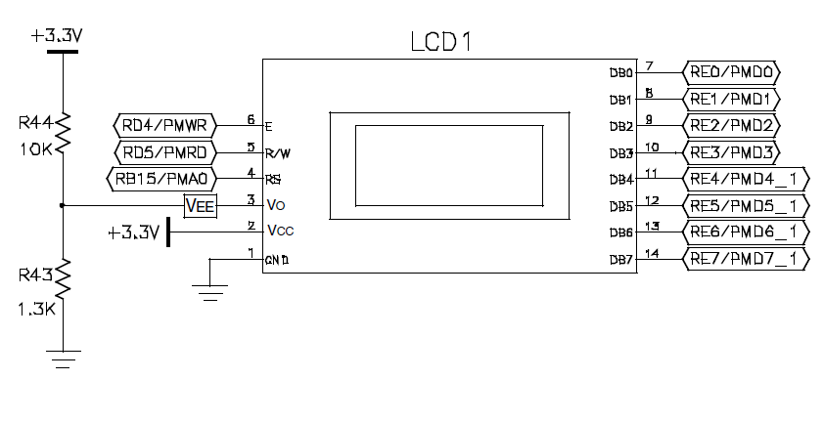

dsPIC33 Connection to LCD Controller
Notes:
The parallel interface consists of control bits and data bus bits.
The 3 control bits are described. The 8 data bits are the lower byte of the RE port. There is an option to use only a 4 bit data bus if you are using a smaller processor. The data bus is by directional beside the dsPIC writing data and command, you can also get information from the LCD controller so now the dsPIC pins need by inputs instead of outputs. In the PIC 24 series there is a built in interface bus for the LCD called a PMP or Parallel Master Port

Slide 21
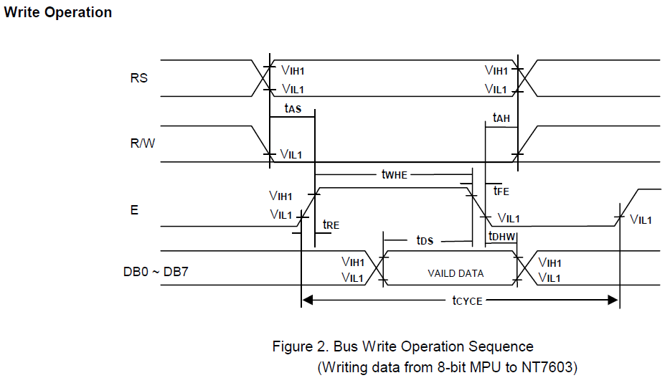
Write Cycle (Command or Data)
Notes:
t_{RE} and t_{FE} are the rise and fall times maximums they can be no longer than 25 ns.
tas is the RS and R/W setup time and a minimum of 60 ns is needed.
twhe is the minimum time that enable must be true it is 300 ns.
tds is the data setup time at a minimum it must be 150 ns
Tdhw is the data hold time and it must be at least 10 ns.
Tah is the hold time for RS and R/W it must at least 10ns
Tcycle is the minimum cycle time for a write that is 500 ns

Slide 22
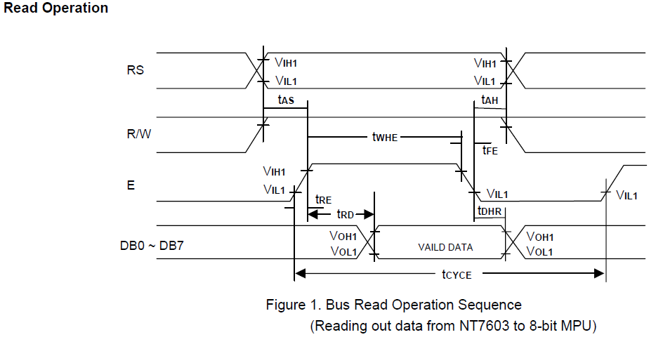
Read Cycle
Notes:
RS = high for data register read RS= low for busy flag read
t_{RE} and t_{FE} are the rise and fall times maximums they can be no longer than 25 ns.
tasa is the RS and R/W setup time and a minimum of 60 ns is needed.
twhe is the minimum time that enable must be true it is 300 ns.
trd is read data output delay and it a maximum of 190ns
Tdhr is the data hold time and it will be at a minimum of 20 ns.
Tah is the hold time for RS and R/W it must at least 10ns
Tcycle is a minimum of 500 ns.

Slide 23
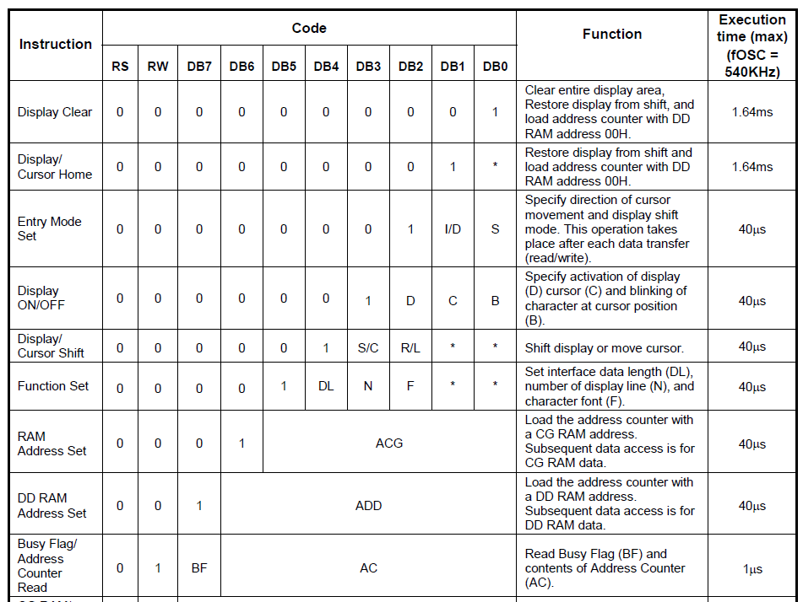
LCD Commands (dsPIC -> LCD)
Notes:
Refer to Novatek data sheet page 14 for full meaning of commands
Notice you can set up CGRAM address, if you do any data read or write will then be in CGRAM

Slide 24
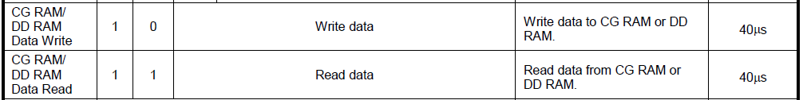
LCD Data Writes (DDR or CGR)

Slide 25
C Routine to Write a Command
#define RW LATDbits.LATD5 // LCD R/W signal
#define RS LATBbits.LATB15 // LCD RS signal
#define E LATDbits.LATD4 // LCD E signal
#define DATA LATE // Port for LCD data
void lcd_cmd( char cmd ) // subroutiune for lcd commands
{
DATA &= 0xFF00; // prepare RE0 - RE7
DATA |= cmd; // command byte to lcd
RW = 0; // ensure RW is 0
RS = 0;
E = 1; // toggle E line: only need 60 ns of setup time
Nop(); //in P33fj256gp710A header file
//#define Nop() __builtin_nop()
Nop();
Nop();
E = 0; // hold times are kept since no change in RW, RS or data
Delay(Delay_5mS_Cnt); // 5ms delay
}
Notes:
With a main clock of 32 MHZ an instruction cycle is 1/16e6 = 62.5 ns, so at this frequency we should think about using 5 Nop marcros = 312.5 ns to get the minimum E time on of 300 ns
The 5 ms delay is excessive since the maximum time that a delay can take is 1.64 ms at nominal frequency, 2.33 at slowest osc
What’s a ms? it is 16K instructions!

Slide 26
C Routine to Write Data
#define RW LATDbits.LATD5 // LCD R/W signal
#define RS LATBbits.LATB15 // LCD RS signal
#define E LATDbits.LATD4 // LCD E signal
#define DATA LATE // Port for LCD data
void lcd_data( char data ) // subroutine for lcd data
{
RW = 0; // ensure RW is 0
RS = 1; // assert register select to 1
DATA &= 0xFF00; // prepare RE0 - RE7
DATA |= data; // data byte to lcd
E = 1;
Nop();
Nop();
Nop();
E = 0; // toggle E signal
RS = 0; // negate register select to 0
Delay_Us( Delay200uS_count ); // 200uS delay
Delay_Us( Delay200uS_count ); // 200uS delay
}
Notes:
Again the delay time seems excessive since the execution time is 40 us (57 us slowest) not 200 us .
Also what would be a way to make the code more efficient (not waiting in a delay function)?

